Slide 1
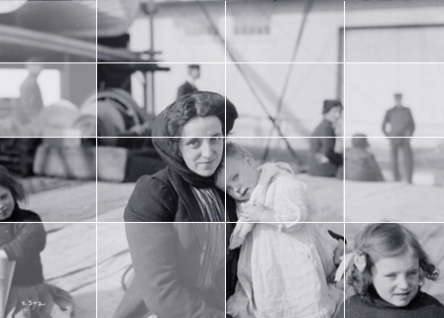
The Canadian Immigrant Experience

Slide 2
Where did everyone come from?
Look at the chart on p.58 of your text
Where was everyone coming from?
Pg. 59 of text

Slide 3
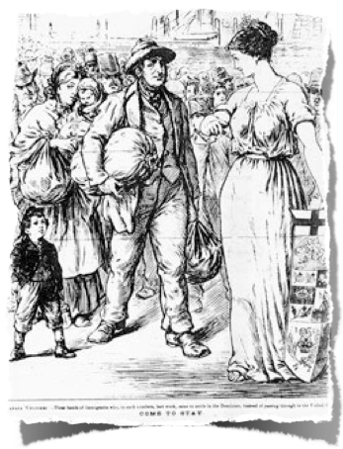
Why Come to Canada?
Unemployed and landless labourers (in Scotland and Ireland)
Australia too far and USA hostile to British Crown
Escape extreme poverty & hunger
Overpopulated cities
Fugitive slaves dreamed of freedom in Canada
Advertising posters embellished an optimistic life
Chance for a better life

Slide 4
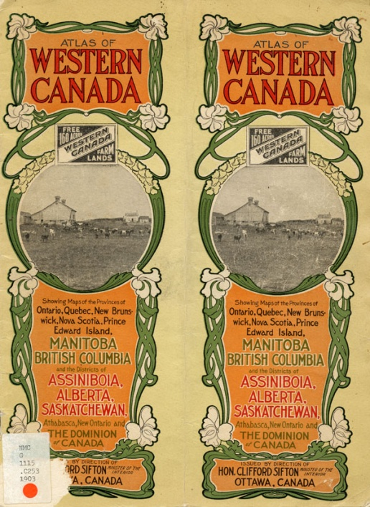
Incentives
Land was cheap and plentiful in Canada
Govt grants of free 50 acres to immigrants
Colourful posters wooed Europeans

Slide 5
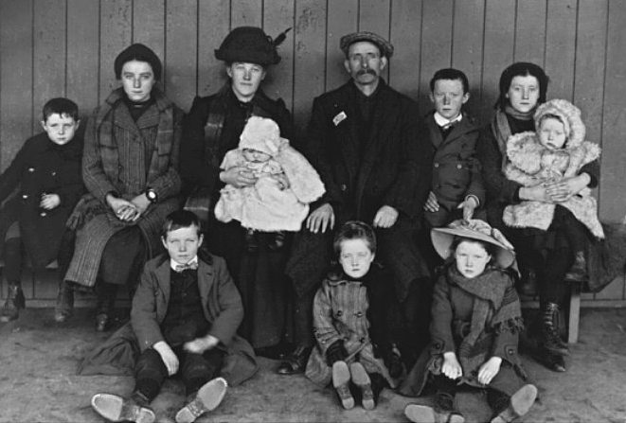
English immigrants to Canada, 1811.
ID #20154: Credit: National Archives of Canada, PA10494

Slide 6
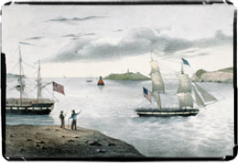
The Journey – A rude Awakening
The same ships used to export lumber to the British Isles transported immigrants to Canada
Noisy, smelly, unsanitary, cramped....led to
DISEASE
Many travellers became ill and died at sea
Contagious diseases were rampant
Cholera, small pox

Slide 7
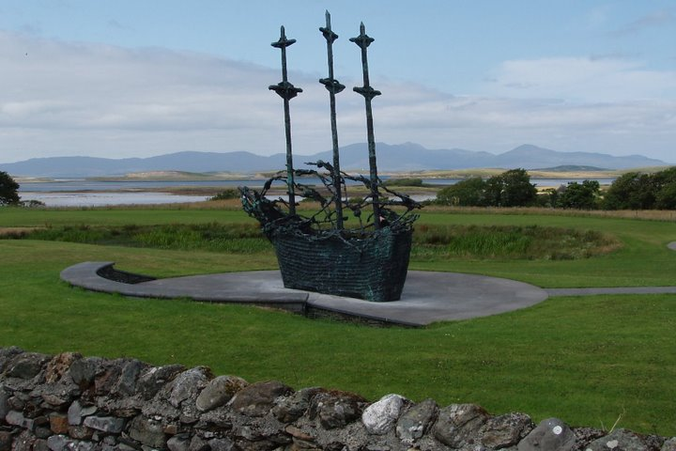
Coffin Ships
refers to the ships that carried Irish Immigrants escaping the effects of the Potato Famine as well as displaced Scottish tenant farmers.
Owners of coffin ships provided as
little food, water, and living space
as legally possible.
This left the ships overcrowded
and disease ridden.
1 in 28 people died aboard ship in the 1830s and 40s.

Slide 8
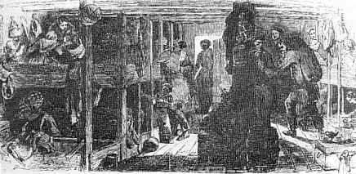
Steerage
Cost of FIRST CLASS Accommodation:
30 pounds, included a cabin, good meals,and a window
STEERAGE
the area below deck, used to store cargo
250+ people in a space 28.5m by 7.5m and 1.5m high
Food was rancid, clean water and clean air non-existent

Slide 9
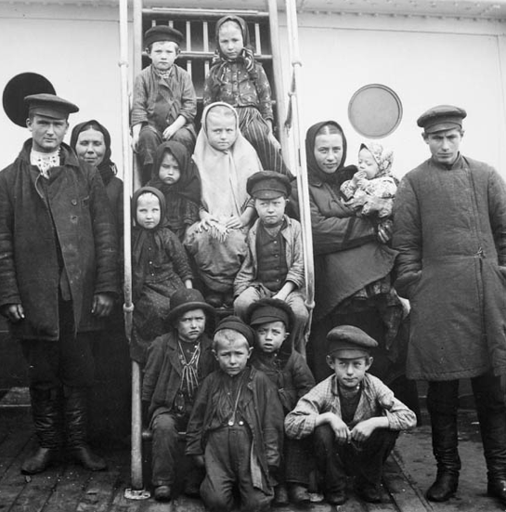
Cholera Epidemic
1832 – Lower Canada passed the Quarantine Act and built a quarantine station
Hoped to protect the city from the spread of the contagious disease.
Because cholera was linked to immigrant ships, the epidemic increased fear and hatred of immigrants

Slide 10
Cholera
What is it?
A diarrheal illness caused by infection of
the intestine with bacteria
Symptoms including watery diarrhea, vomiting, and leg cramps
Rapid loss of bodily fluids → dehydration & shock
Without treatment → death in hours
How do you get it?
Drinking water or eating contaminated food
Source of contamination is usually the feces of an infected person

Slide 11
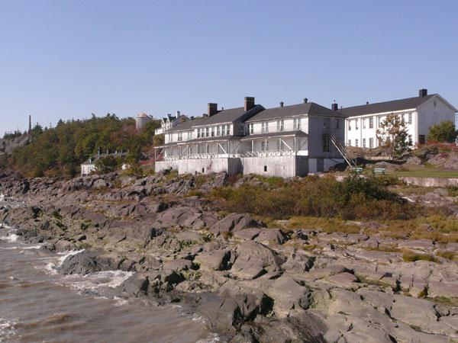
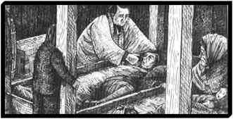
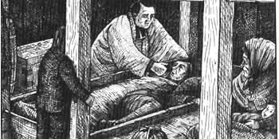
Life and Death on Grosse Ile (Quarantine Station)
Station became overcrowded
Eventually ships not carrying Irish passengers were allowed through.
Canadians associated the disease exclusively with the Irish, rather than recognizing the true causes:
overcrowding
poor sanitary conditions

Slide 12
PUSH vs. PuLL FACTORS
Sometimes immigration can be examined in terms of push and pull factors.
Push Factors refers to reasons why people emigrate from their home country
Pull Factors refers to what attracts people to the country they immigrate.
Example: Escape from poverty is a push factor, the availability of jobs is the related pull factor.
Name at least 3 Push and Pull factors affecting Canadian immigration between 1815 -1865.

Slide 13
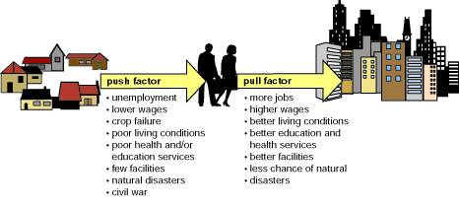
Push - Pull Factors

Slide 14
Spring Break Project
What are the push - pull factors that brought your family to Canada?
What are the important factors in your family’s life, and culture that root you to Canada?

